Slide 1
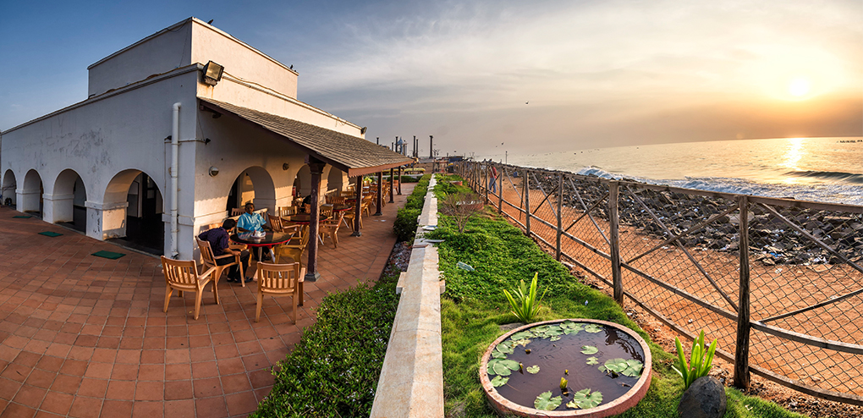
Pondicherry Assembly Election 2016
Presented By
Manikandan

Slide 2
Eligible Voters – The power of women
For 2016 Assembly election in Pondicherry, around 9,41,935 people were eligible to vote.
As like the census data of 2011, the male female ratios(1000:1038) of Pondicherry continued to impact the male female voters ratio too.
The Number of female voters were greater than male voters. So it clearly tells to the political parties that they need to make their Election Manifesto in way a attracts this major category voters.
Out of 9,41,935 voters, 4,94,412 voters were female.
The female voters ratio is not only high in few constituencies. Each constituency of 30 were having more than 50 % of female voters.
Voters by Constituency wise and male-female voters were presented in next two slides.

Slide 3
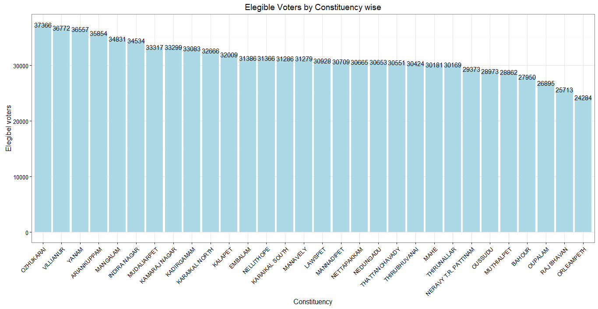

Slide 4
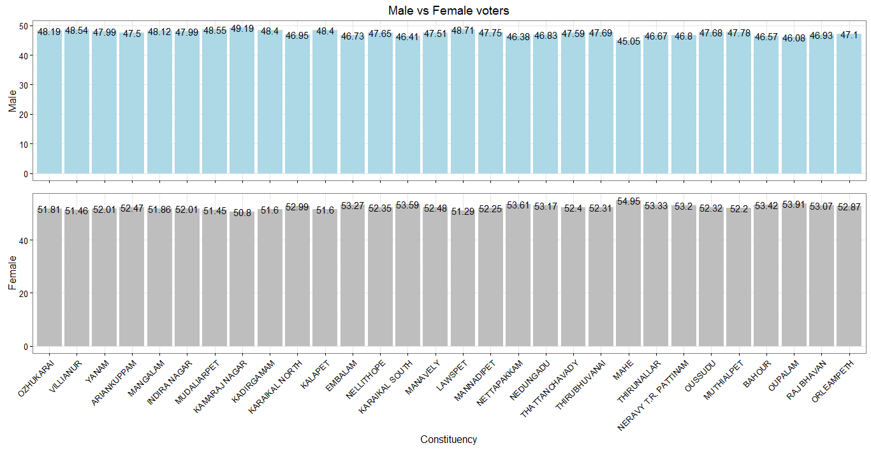

Slide 5
Poll percent - Pondicherry remains Top
Pondicherry achieved again the above eighty mark of poll percent 81.94 %.
Yanam is the Constituency which was in top place of Polling list with 92.73 %.
Karaikal South is the Constituency which was in last place of Polling list which 76.07%. It was believed that due to heavy rain on poll date in Karaikal reduced the percent.
Only five Constituencies were below the eighty mark of poll percent and all the remaining 25 constituency were above 80 % of Poll percent.
Kamaraj Nagar is the Constituency where we saw huge number of voters didn’t participated this election. The number is 7,530.
Why some people in Kamaraj Nagar didn’t cast their votes is need to investigated.

Slide 6
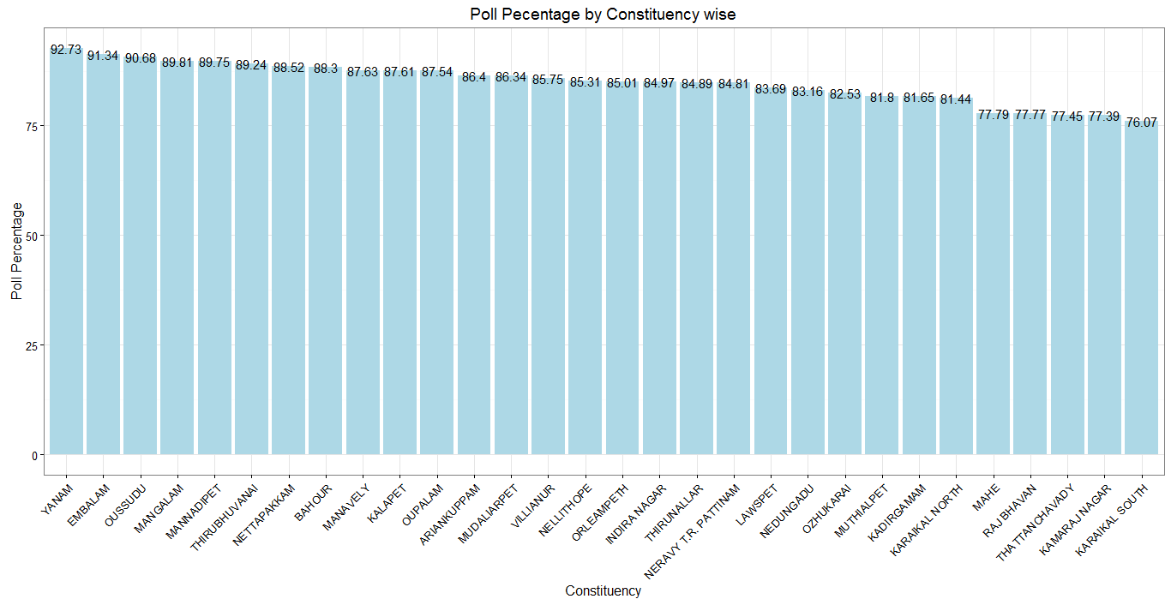

Slide 7
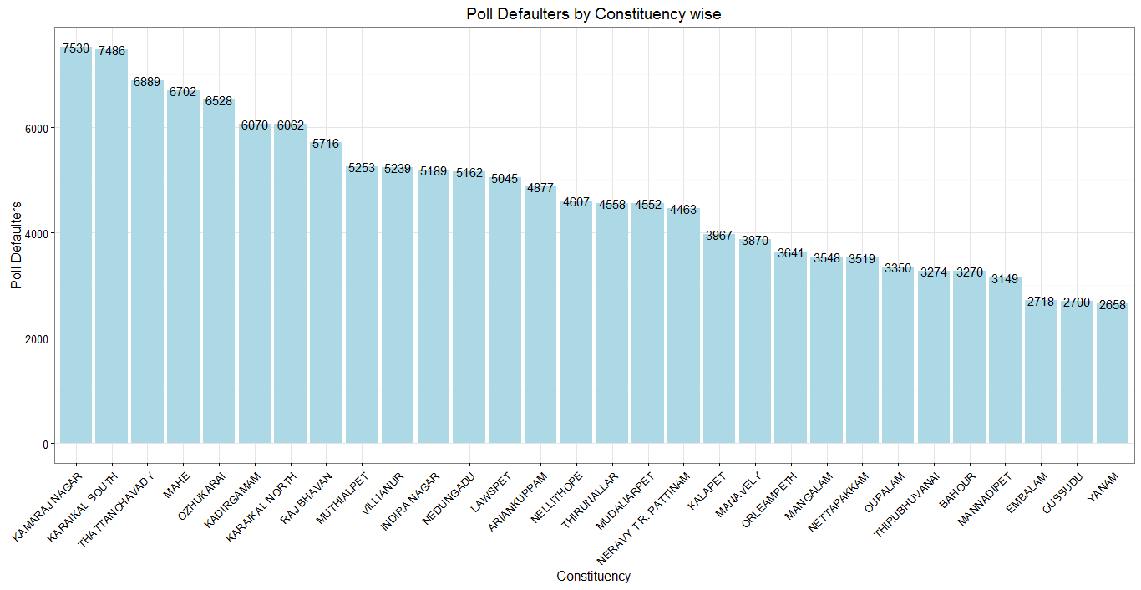

Slide 8
Candidates – The joy of Independent
Out of 344 contested candidates, 27.90 % of contested candidates were Independent(don’t represent any political party) candidates.
27.90% of Independent candidates shows that peoples out of political parties showing interest in contesting election.
Ozhukarai is the Constituency which had maximum number of contested candidates of 17.
Karaikal North is the constituency which had minimum number of contested Candidates of 8.
Embalam is the only constituency which hasn’t seen a independent candidates among the 9 contesting members.

Slide 9
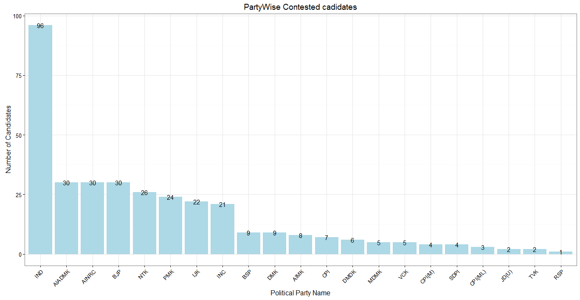

Slide 10
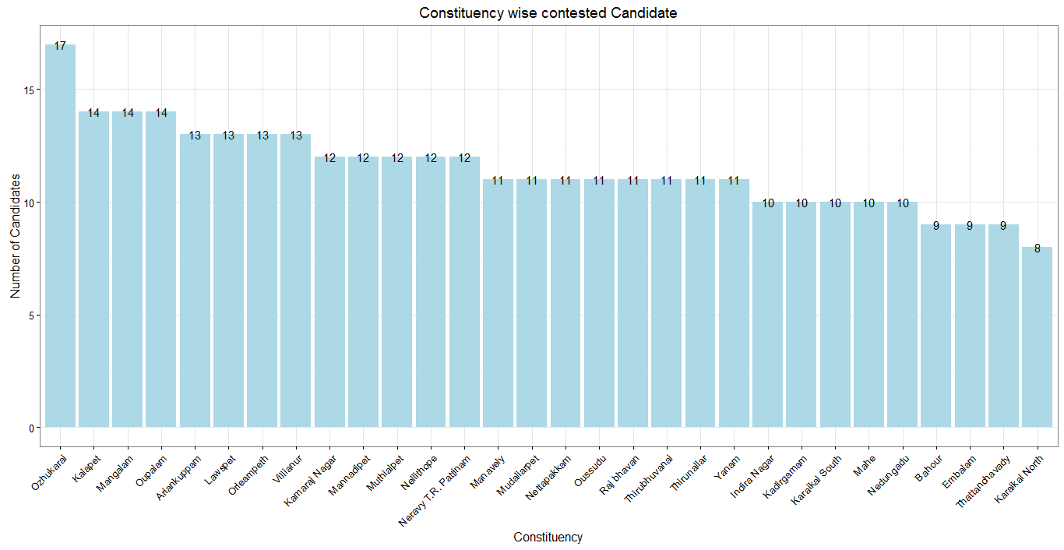

Slide 11
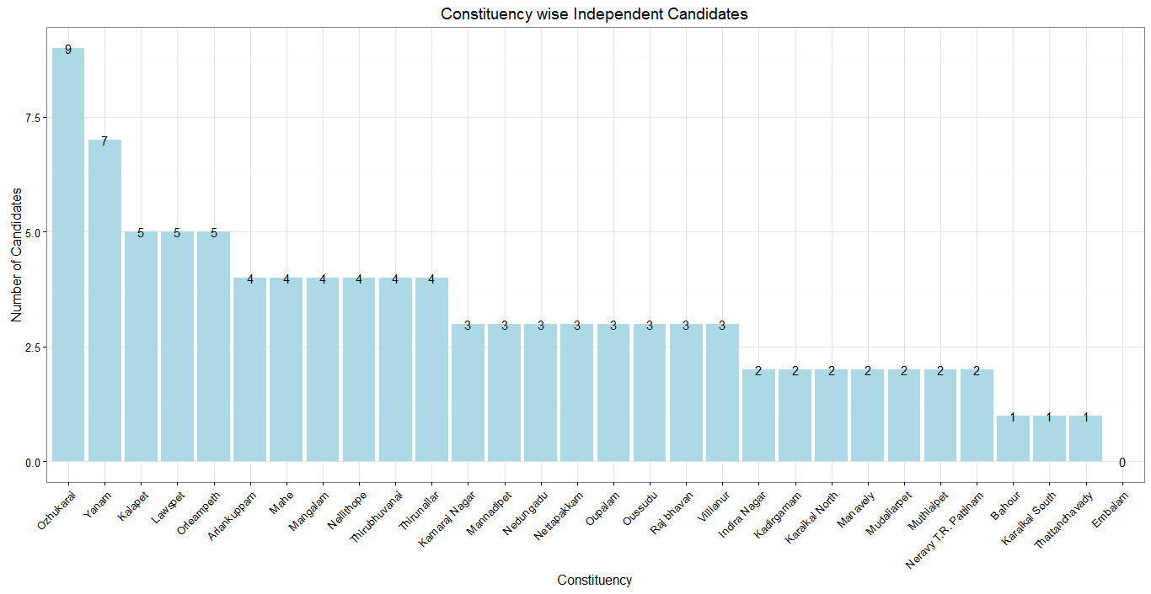

Slide 12
NOTA – useless button
Around 13,240 people were casted their votes in NOTA. But since this was only 1.65 % in total polled votes, Their votes became useless.
And also it doesn’t seems the Election Commission have rule/plan of reelection when the NOTA votes crossed some considerable percent.
So until the Election commission formulate those kind of rules, this Votes going as Not considerable votes.
3.9 % of Thattanchavady constituency people registered NOTA votes and this is the high proportion in compare with all other constituency.
0.42 % of Yanam constituency people registered NOTA votes and this the Low proportion in compare with all other constituency.

Slide 13
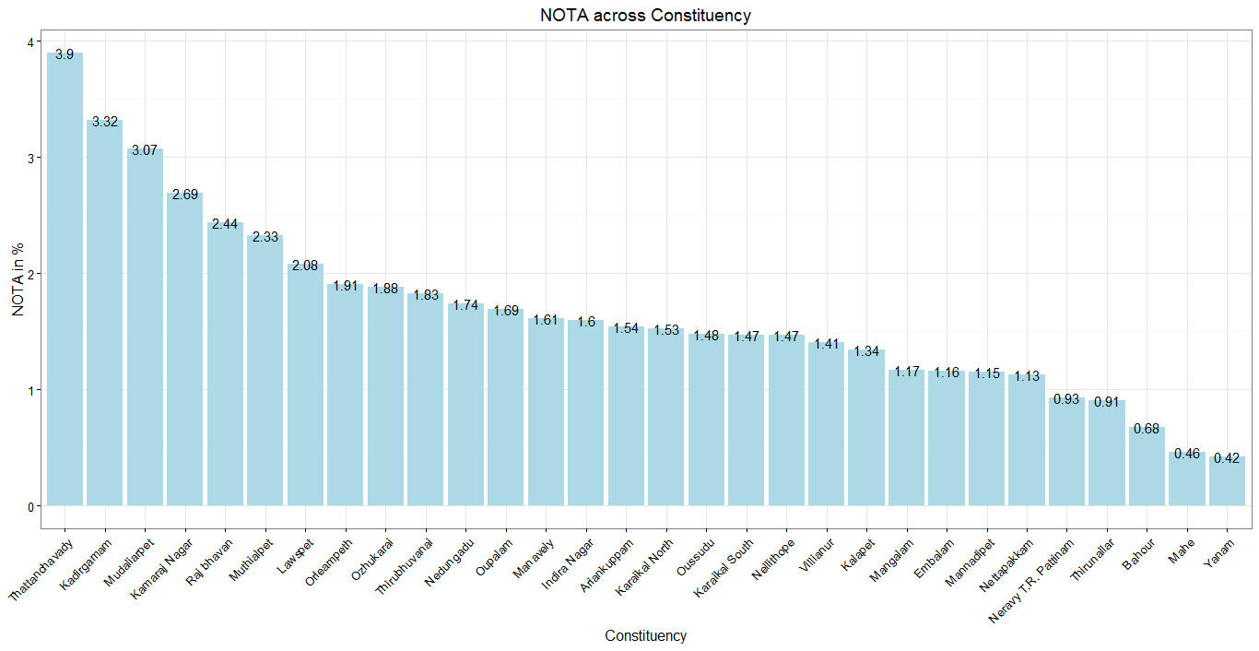

Slide 14
Time to switch to Percentage wise representation in Assembly
Congress & DMK tie up is currently formed government in Pondicherry. But this parties secured only 39.45 % (Congress - 30.6% & DMK - 8.85)of votes.
So 60.55 % percent of people rejected both the parties but they need to accept the government since no other secured that much.
Other than this tie up , NR Congress secured 28.12 % and AIADMK secured 18.82 % , Independent candidates secured 7.86 %.
Both the percentage wise and total votes wise graphs in next two slides shows detailed vote share between all political parties.

Slide 15
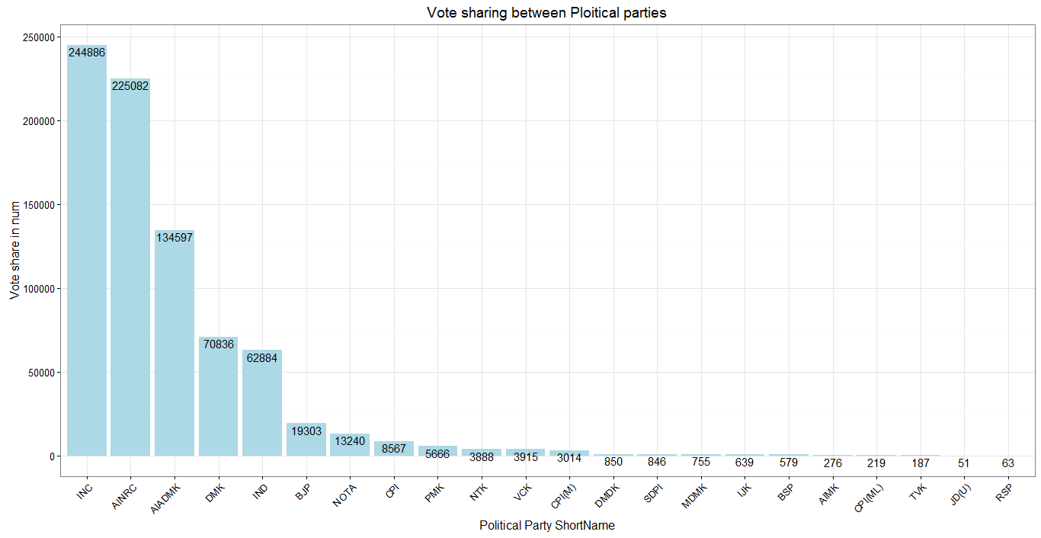

Slide 16
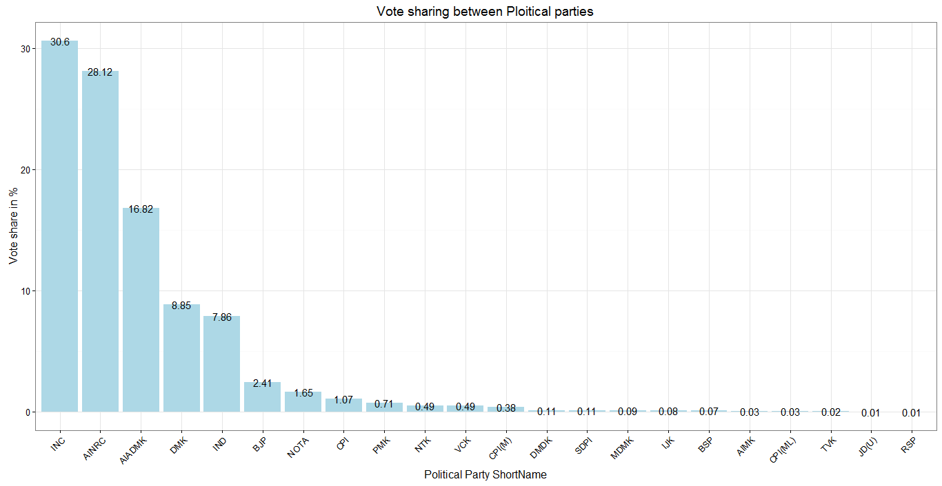

Slide 17
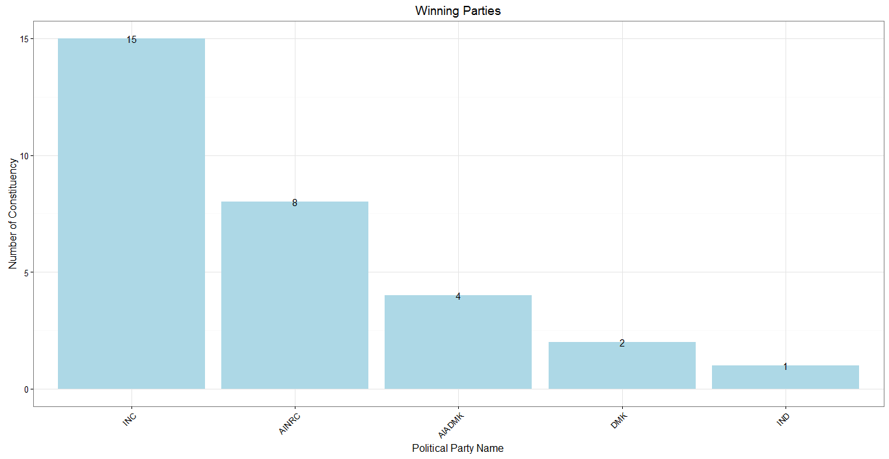
Party wise winning candidates count

Slide 18
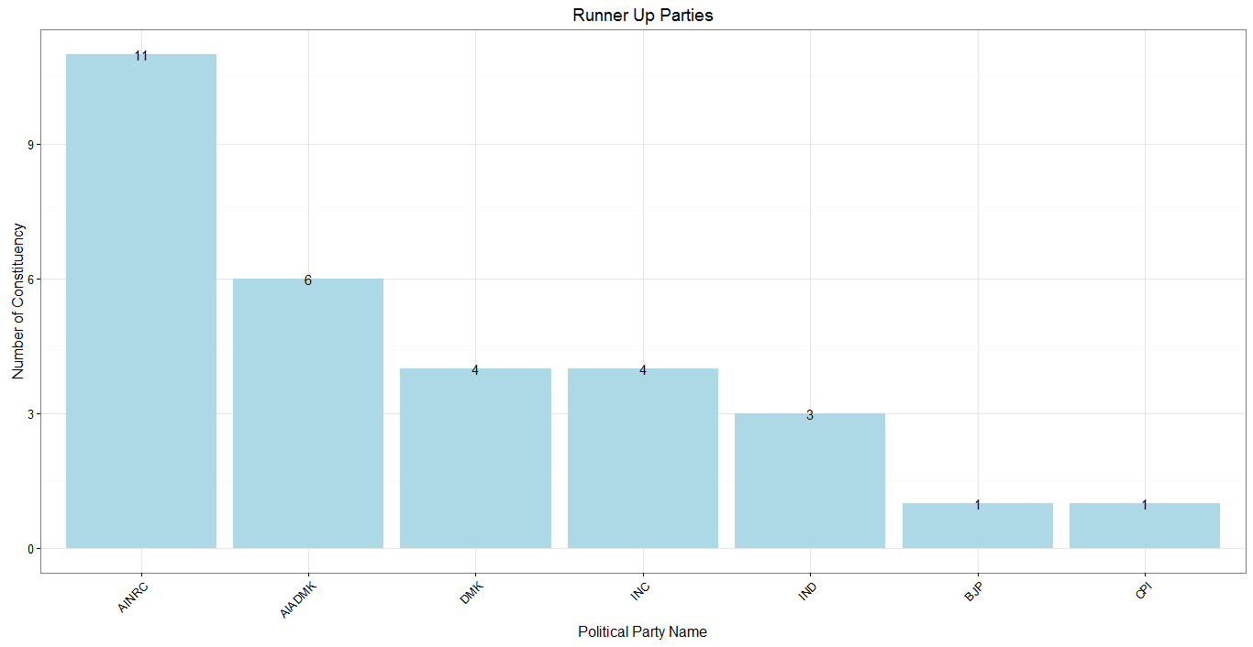
Party wise RunnerUp candidates count

Slide 19
Dance of Democracy
Out of 30 winning candidates, only 9 candidates were secured votes greater than 50 % of votes in their respective Constituency.
The lowest percent of votes secured by a winning candidate was 27.86% and the candidate name is T.P.R. Selvame for Mannadipet constituency.
The Highest percent of votes secured by a winning candidate was 69.16% and the candidate name is A. Johnkumar for Nellithope constituency .
Other then this Dance of Democracy, winning candidate K.A.U. Asana won by only just 20 votes of difference in Karaikal South.
Winning candidate A. Johnkumar won by 12,141 votes of difference.

Slide 20
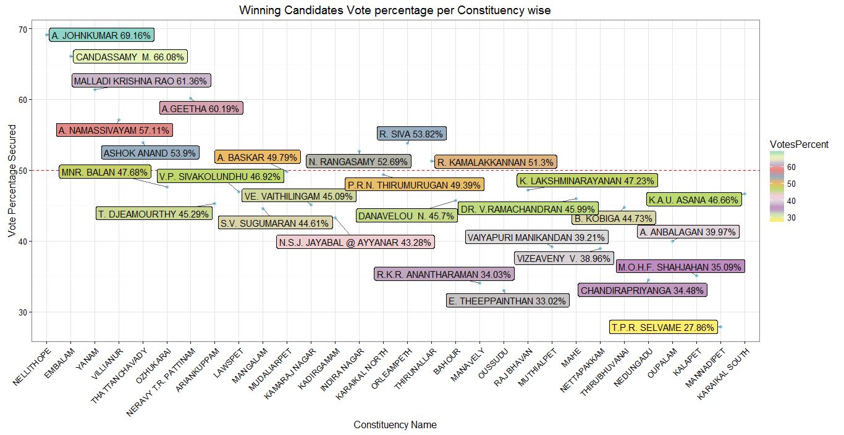

Slide 21
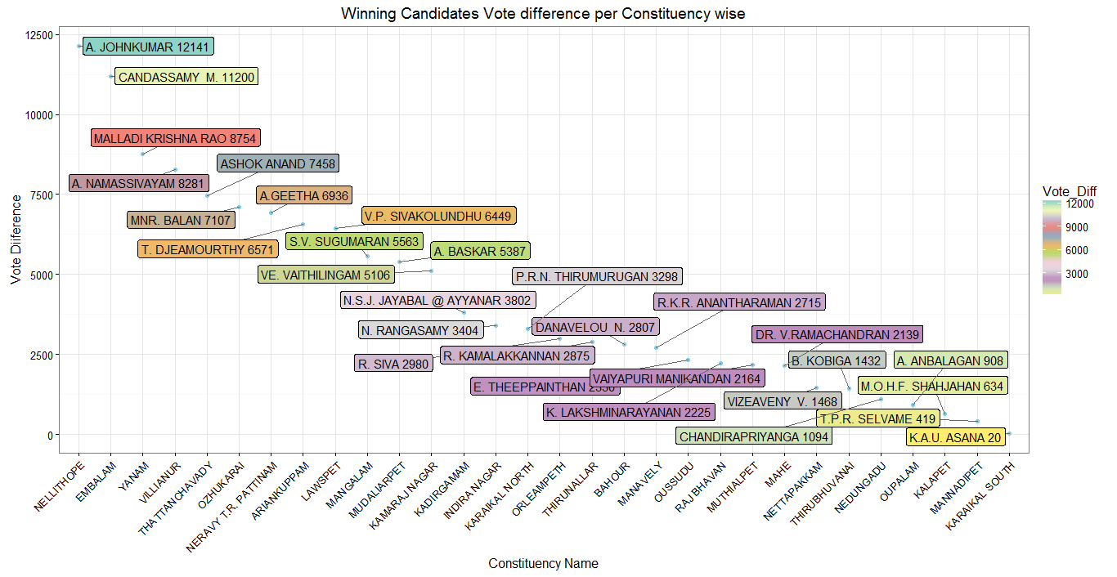

Slide 22
Reference
http://eciresults.nic.in/ConstituencywiseU071.htm?ac=1
http://ceopuducherry.py.gov.in/rolls/ac.htm

Slide 23
Party ShortNames used in the Visualization
Party | PartyShortName
All India N.R. Congress | AINRC
Dravida Munnetra Kazhagam | DMK
All India Anna Dravida Munnetra Kazhagam | AIADMK
Independent | IND
Pattali Makkal Katchi | PMK
Desiya Murpokku Dravida Kazhagam | DMDK
Bharatiya Janata Party | BJP
Bahujan Samaj Party | BSP
Indiya Jananayaka Katchi | IJK
Agila India Makkal Kazhagam | AIMK
None of the Above | NOTA
Indian National Congress | INC
Communist Party of India (Marxist) | CPI(M)
Viduthalai Chiruthaigal Katchi | VCK
Naam Tamilar Katchi | NTK
Marumalarchi Dravida Munnetra Kazhagam | MDMK
Communist Party of India (Marxist-Leninist) (Liberation) | CPI(ML)
SOCIAL DEMOCRATIC PARTY OF INDIA | SDPI
Communist Party of India | CPI
Revolutionary Socialist Party | RSP
Janata Dal (United) | JD(U)
Tamizhaga Vaazhvurimai Katchi | TVK

Slide 24
R code to Web scrapping the data from Election commission website

Slide 25
Your comments are always welcome

